Slide 1
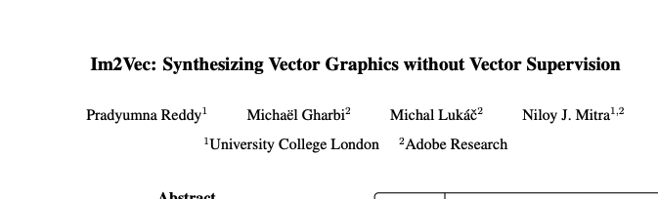
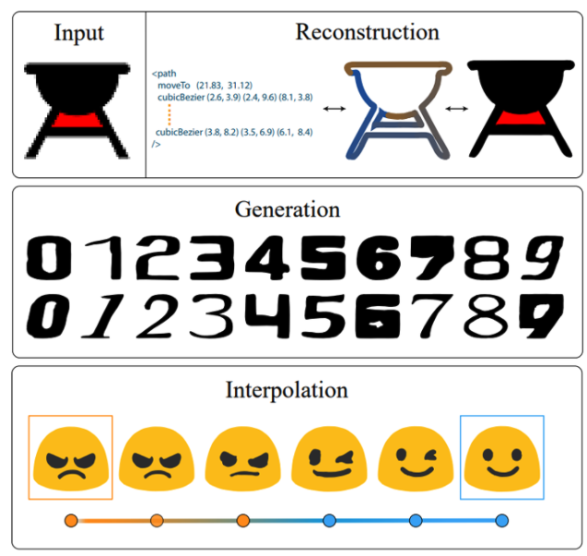
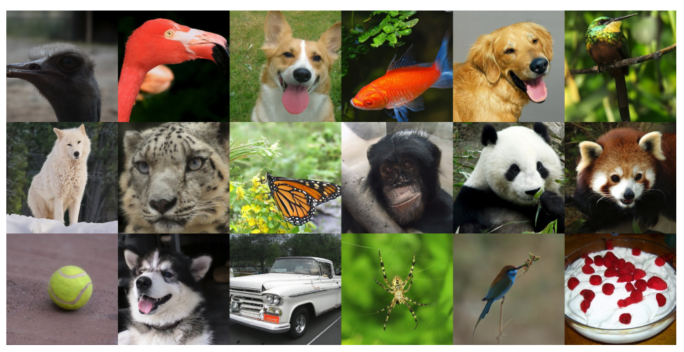

Slide 2
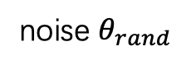

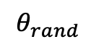
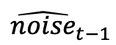
Encoder
z
KL loss
x_0
t
noise $θ_{rand}$
x_0t
diffusion
$${\hat{noise}}_{t−1}$$
pre-trained VAE
x_0t, z_0
$$φ$$
mse loss
z_0
$$θ_{rand}$$
z_1
…
z_n

Slide 3
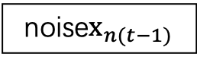
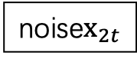
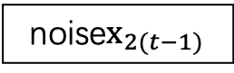
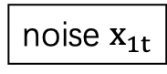
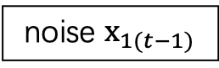
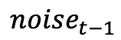
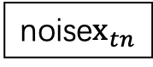

loop
noise $x_{1t}$
noise$x_{2t}$
…
diffusion
$${noise}_{t−1}$$
noise$x_{tn}$
z_0
noise $x_{1(t−1)}$
$$φ$$
z_1
noise$x_{2(t−1)}$
…
…
z_n
noise$x_{n(t−1)}$
loop

Slide 4
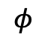
GT
Encoder
z
KL loss
x_0
x_0t
x_0t, z_0
x_1
x_1t
x_1t, z_1
noise $θ_{rand}$
diffusion
$${\hat{noise}}_{t−1}$$
…
…
…
x_n
x_nt
x_nt, z_n
mse loss
pre-trained AE
$$θ_{rand}$$
z_0
$$φ$$
z_1
…
z_n

Slide 5
GT
GT
delta
[a_0,
a_1,
…,
a_21]
[a_0+delta_0,
a_1+delta_1,
…,
a_21+delta_21]
delta
diffvg
无法降低解空间
1️⃣
diffvg
[delta_0,
delta_1,
…,
delta_21]
[delta_0,
delta_1,
…,
delta_21]
Encoder
z
Decoder
MSE Loss

Slide 6
GT
GT
delta
[a_0,
a_1,
…,
a_21]
[a_0+delta_0,
a_1+delta_1,
…,
a_21+delta_21]
delta
diffvg
Encoder
z
Decoder
2️⃣
diffvg
MSE Loss
有很多的图片是空的，但是空图片也是有意义的，通过这种方式很难学到这种意义
空图片应该有相同的latent code，才能实现降低解空间
[a_0,
a_1,
…,
a_21]
[a_0+delta_0,
a_1+delta_1,
…,
a_21+delta_21]
delta
Encoder
z
Decoder
3️⃣
diffvg
diffvg
MSE Loss

Slide 7
🀙
🀚
🀛
[a_0,
a_1,
…,
a_12]
[a_0+delta_0,
a_1+delta_1,
…,
a_12+delta_12]
delta
diffvg
Encoder
(AE)
z
Decoder
diffvg
MSE Loss
method: vanilla VAE
beta-VAE

Slide 8
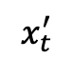
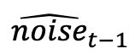
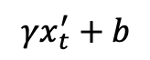
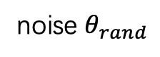
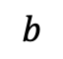
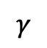
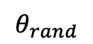
Workflow 1
GT
🀙
Not work!!!
🀞
reparameterized
Encoder
z
🀚
x_0
x_0t
x_0t z_0
🀛
x_1
x_1t
🀝
x_1t z_1
🀟
🀡
noise $θ_{rand}$
Diffusion
…
…
…
$${\hat{noise}}_{t−1}$$
x_n
x_nt
x_nt z_n
mse loss
🀜
$$θ_{rand}$$
pri_0
diffvg
z_0
pri_1
z_1
Encoder
(AE)
…
…
pri_n
z_n
🀠
Improvement: AdaIn
z
MLP
$$γ$$
t
[t, sin(t), cos(t)]
c_tx
MLP
$$b$$
$$γx_{t}^{′}+b$$
x_t
MLP
$$x_{t}^{′}$$

Slide 9
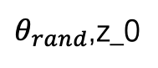
Workflow 2
GT
🀙
Not work!!!
🀞
reparameterized
Encoder
z
🀚
x_0
x_0t
x_0t z_0t
🀛
x(12)
x_1
x_1t
🀝
x_1t z_1t
🀟
🀡
noise $θ_{rand}$
Diffusion
…
…
…
$${\hat{noise}}_{t−1}$$
diffvg
mse loss
x_n
x_nt
x_nt z_nt
🀜
$$θ_{rand}$$
pri_0t
z_0t
3+256
pri_1t
z_1t
$θ_{rand}$,z_0
…
Encoder
(AE)
…
pri_nt
z_nt
🀠
Improvement: AdaIn
z
MLP
$$γ$$
t
[t, sin(t), cos(t)]
c_tx
MLP
$$b$$
$$γx_{t}^{′}+b$$
x_t
MLP
$$x_{t}^{′}$$

Slide 10
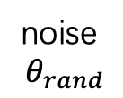
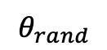
Workflow 3
GT
🀙
🀞
reparameterized
Encoder
z
🀚
x_0
🀛
x_0t
pri_0t
🀜
z_0t
noise
$$θ_{rand}$$
x_1
x_1t
pri_1t
z_1t
🀟
🀡
diffvg
Encoder
(AE)
🀝
Diffusion
…
…
…
…
$${\hat{noise}}_{t−1}$$
x_n
x_nt
pri_nt
z_nt
mse loss
$$θ_{rand}$$
🀠
Improvement: AdaIn
z
MLP
$$γ$$
t
[t, sin(t), cos(t)]
c_tx
MLP
$$b$$
$$γx_{t}^{′}+b$$
x_t
MLP
$$x_{t}^{′}$$

Slide 11
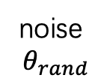
Workflow 4
GT
🀙
🀞
reparameterized
Encoder
z
🀚
x_0
🀛
pri_0
🀜
z_0
z_0t
noise
$$θ_{rand}$$
x_1
diffvg
pri_1
🀝
z_1
z_1t
🀟
🀡
Encoder
(AE)
Diffusion
…
…
…
…
$${\hat{noise}}_{t−1}$$
x_n
z_nt
mse loss
pri_n
z_n
$$θ_{rand}$$
🀠
Improvement: AdaIn
z
MLP
$$γ$$
t
[t, sin(t), cos(t)]
c_tx
MLP
$$b$$
$$γx_{t}^{′}+b$$
x_t
MLP
$$x_{t}^{′}$$

Slide 12
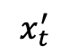
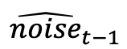
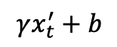
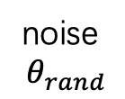
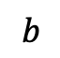
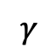
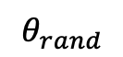
[a_0,
a_1,
…,
a_12]
[a_0+delta_0,
a_1+delta_1,
…,
a_12+delta_12]
Encoder
(AE)
delta
diffvg
z
Decoder
MSE Loss 1
[delta_0,
delta_1,
…,
delta_12]
diffvg
MLP
MSE Loss 2
GT
🀙
🀞
reparameterized
Encoder
z
🀚
x_0
🀛
pri_0
🀜
z_0
z_0t
noise
$$θ_{rand}$$
x_1
diffvg
pri_1
🀝
z_1
z_1t
🀟
🀡
Encoder
(AE)
Diffusion
…
…
…
…
$${\hat{noise}}_{t−1}$$
x_n
z_nt
mse loss
pri_n
z_n
🀠
$$θ_{rand}$$
z
MLP
$$γ$$
t
[t, sin(t), cos(t)]
c_tx
Improvement: AdaIn
MLP
$$b$$
$$γx_{t}^{′}+b$$
x_t
MLP
$$x_{t}^{′}$$

Slide 13

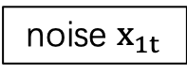
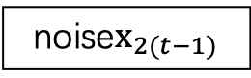
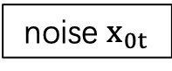
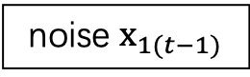
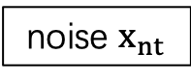
sample
noise $x_{0t}$
x_0t z_0
noise $x_{1t}$
🀝
x_1t z_1
🀟
🀡
…
…
Diffusion
$${\hat{noise}}_{t−1}$$
noise $x_{nt}$
x_nt z_n
🀜
z_0
noise $x_{1(t−1)}$
pri_0
z_1
noise$x_{2(t−1)}$
diffvg
pri_1
Encoder
(AE)
…
…
…
pri_n
z_n
noise$x_{n(t−1)}$
loop

Slide 14


9
8
10
7
11
6
0
5
1
4
2
multiple primitive
3

Slide 15
9
9
8
10
8
10
7
11
7
11
6
0
6
0
5
1
5
1
4
2
4
2
3
3

Slide 16
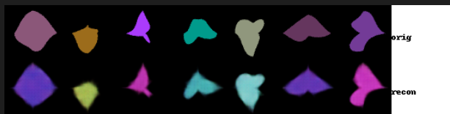
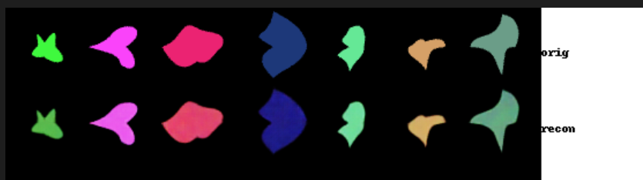
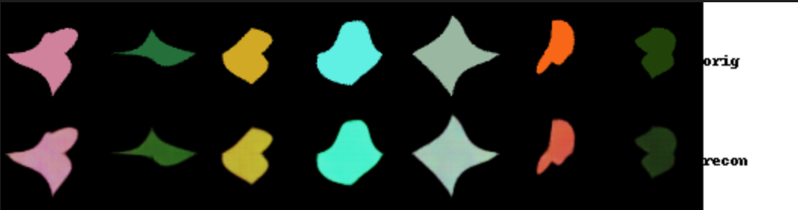
z=8
kl 60
mse 0.003
z=512
kl 21
mse 0.002
z=128
kl 23
mse 0.002

Slide 17
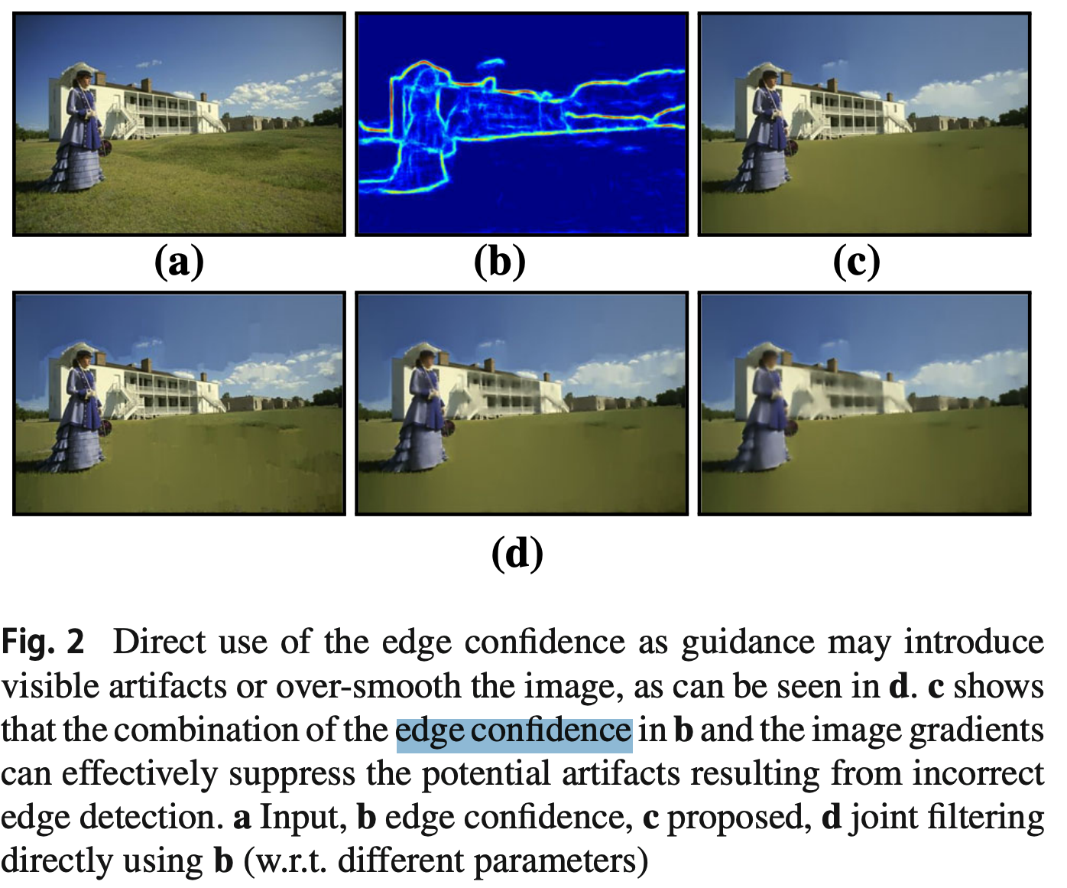
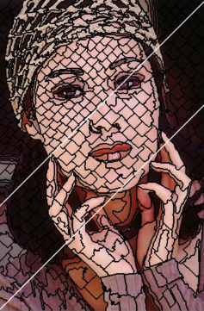
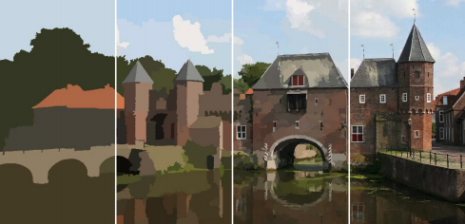
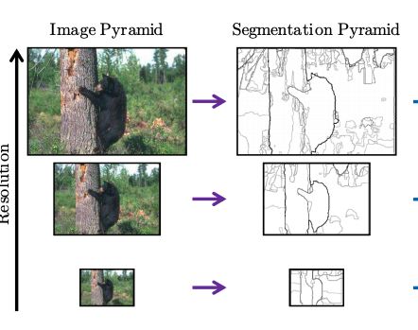
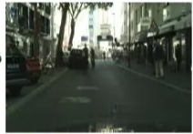
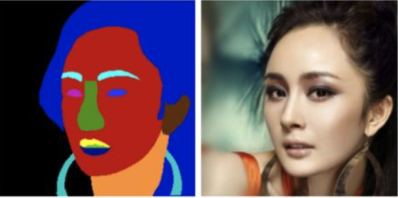
✦★✶✷✸
🀚
✷
Direct smooth
use N primitives to fit every superpixel
✦
https://github.com/laixintao/slic-python-implementation.git
https://github.com/shenjianbing/Real-time-Superpixel-Segmentation-by-DBSCAN-Clustering-Algorithm-.git
https://github.com/TArong/Fast-edge-detection-using-structured-forests/blob/master/edge-detection-algorithms.pdf
use N (n+4n+16n+64n) primitives to fit every superpixel
★
source code missing!!!
im2mcg.m from https://www2.eecs.berkeley.edu/Research/Projects/CS/vision/grouping/mcg/
✶
https://github.com/jponttuset/mcg/blob/7873db060821c028041f64fc04859389880f9f26/full/src/ucms/img2ucms.m
only for edge!!!
✸
use primitives to fit each object

Slide 18
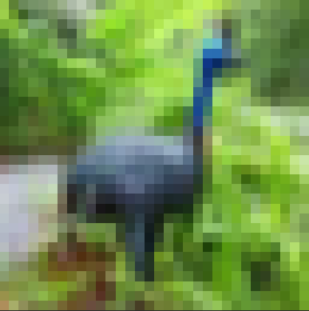
optimized by diffvg

Slide 19
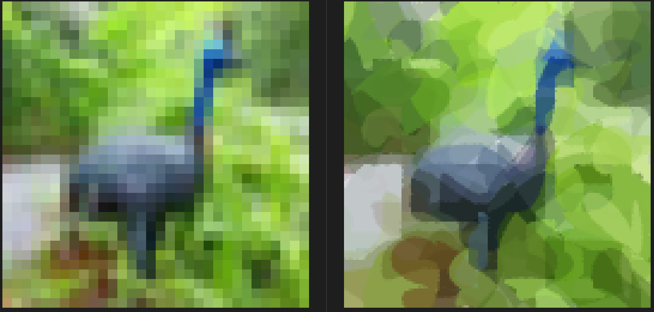
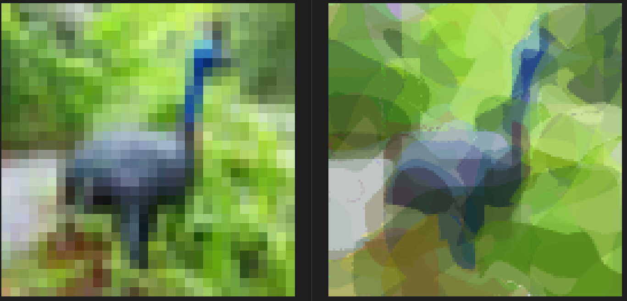
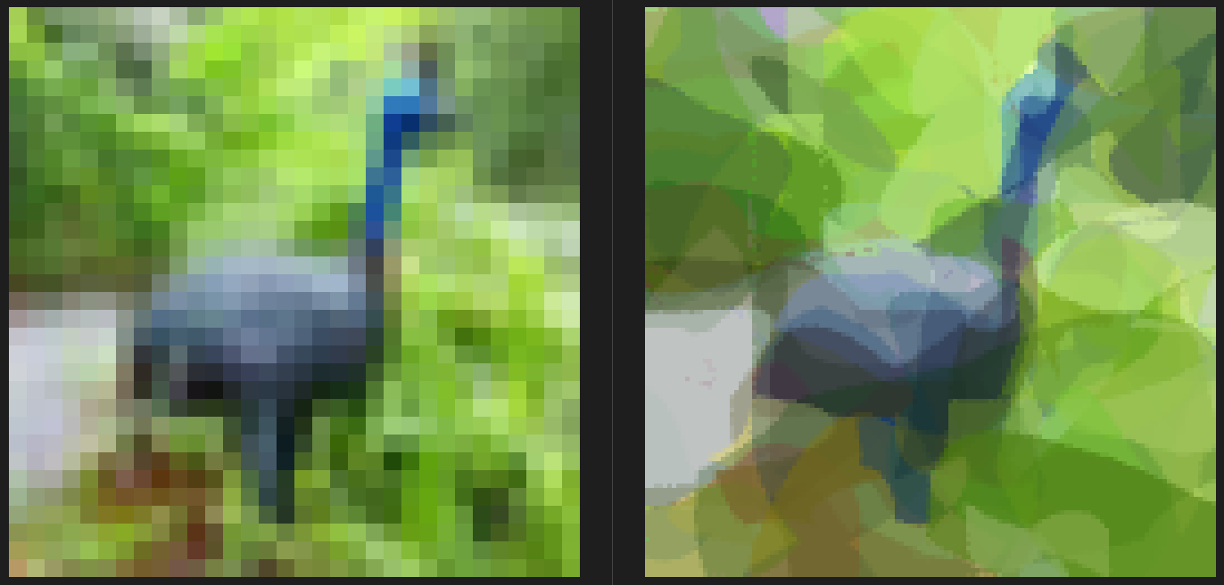



4+4*4+4*4*4; width_optim 0.1; color_vars, 0.01; deltar 0.01; max_width 2.0; step 1000;
4+4*4+4*4*4; width_optim 0.1; color_vars, 0.001; deltar 0.01; max_width 2.0; step 1000; 0.0043
有提升
4+4*4+4*4*4; width_optim 0.1; color_vars, 0.001; deltar 0.01; max_width 16.0; step 1000;
4+4*4+4*4*4; width_optim 0.1; color_vars, 0.001; deltar 0.01; max_width 4.0; step 1000;
none
4+4*4+4*4*4; width_optim 0.1; color_vars, 0.001; deltar 0.001; max_width 2.0; step 1000;
4+4*4+4*4*4; width_optim 0.1; color_vars, 0.001; deltar 0.001; max_width 4.0; step 1000; 0.0057

Slide 20







5+5*4+5*4*4; width_optim 0.1; color_vars, 0.001; deltar 0.01; max_width 2.0; step 1000; 0.0008 (wrong)
5+5*4+5*4*4; width_optim 0.1; color_vars, 0.001; deltar 0.01; max_width 2.0; step 1000;
0.0038
0.0025
0.0024
0.0032
0.0031

Slide 21

Image initial plan
random optim; alpha=1.0; pris 32
Image net

Slide 22





















Slide 23


Slide 24





Slide 25


Slide 26
GT
🀙
🀞
reparameterized
Encoder
z
🀚
x_0
x_0t
x_0t z_0
🀛
x_1
x_1t
🀝
x_1t z_1
🀟
🀡
noise $θ_{rand}$
Diffusion
…
…
…
$${\hat{noise}}_{t−1}$$
x_n
x_nt
x_nt z_n
mse loss
🀜
$$θ_{rand}$$
pri_0
diffvg
z_0
pri_1
z_1
Encoder
(AE)
…
…
pri_n
z_n

Slide 27

x_0
x_t
y_1
y_2
Diffu
q(x_{t-1} | x_t, x_0)
mu, sigma, log(sigma)
q_posterior_mean_variance
_
x_0

